Slide 1



DEPARTMENT OF ELECTRONICS AND COMMUNICATION ENGINEERING
MINOR PROJECT-IV
BATCH-12
FINAL REVIEW
A LOW POWER PSEUDO-NMOS BASED 4:2 COMPRESSOR DESIGN
PRESENTED BY:
MONISHA A - 927621BEC129
POOJA SHREE M - 927621BEC146
SASIREKHA T - 927621BEC189
SATHIYADHARSHINI B - 927621BEC190
GUIDED BY:
MS.S.KAVITHA
Assistant Professor ,ECE

Slide 2
INTRODUCTION
In VLSI circuits and systems, the compressor is a crucial component that is mainly used as a central processing unit. XOR-XNOR and multiplexer modules are used in this study's attempt to create a 4-2 compressor.
The compressor's performance is analyzed in detail and is implemented and simulated using Ltspice software with 90 nm CMOS technology.
Specifically, we include pseudo n-MOS logic in this work to achieve even lower power consumption, which improves overall efficiency across a range of VLSI applications.

Slide 3
PROBLEM STATEMENT
Create a low-power, pseudo-NMOS logic 4:2 compressor that reduces four input bits to two output bits. Maintain performance indicators like speed and accuracy while giving power efficiency first priority. For smooth integration into digital circuits, optimize for the least amount of space required.
Develop a modern VLSI technology that is energy-efficient.

Slide 4
OBJECTIVE
The objective of this project is to design and implement a low-power 4:2 compressor using pseudo-NMOS logic. This compressor will efficiently compress four input bits into two output bits while prioritizing power efficiency.
The main goal is to achieve a balance between power consumption.
The ultimate aim is to provide an energy-efficient solution suitable for integration into modern VLSI technologies, thereby contributing to the development of more power-efficient digital circuits.

Slide 5
LITERATURE SURVEY
V. S. Nagaraju et al. (2021) [1] created a variety of compressors for the Cadence Virtuoso tool, including 5:3, 10:4, 15:4, and 20:5. Compared to CMOS technology, the compressor created with FinFET technology will use less power.
A.Abhilash et al. (2016) [2] presented new 4-2 and 5-2 compressor topologies for low-energyoperations. These architectures were constructed in V HDL and examined with Xilinx instruments, with simulations performed on 180nm TSMC technology. Comparative investigation revealed that incorporating these compressors into multiplier algorithms resulted in better power-efficient performance. Overall, compressors are more efficient in terms of power usage than typical multiplier algorithms.
M.Kumar and S.Kumar (2014) [3] created a 4-2 compressor circuit utilizing OR and XOR logic which performed CMOS technology using LTSPICE.
V.Anandi et al. (2013) [4] developed a hybrid-CMOS 1-bit complete adder for 180nm technology. Top of Form in 2013,
Pishvaie et al [5] simulated a (4-2) compressor design using HSPICE and a 45nm post-layout CCMOS standard cell library.

Slide 6
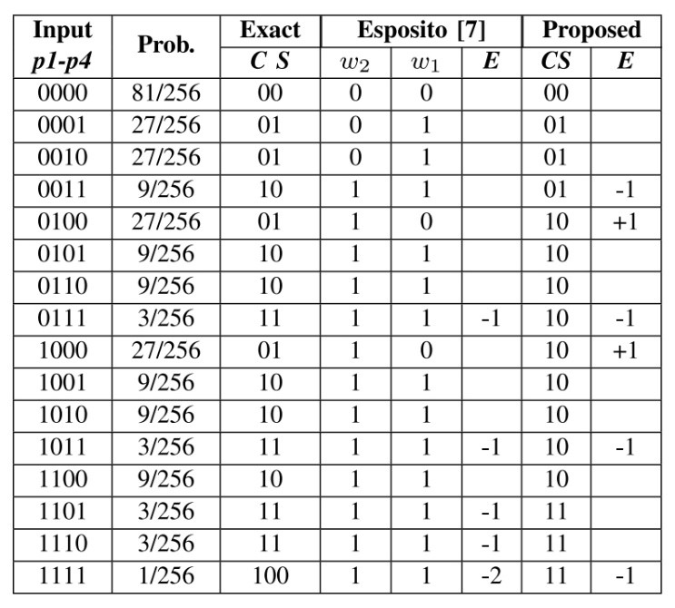
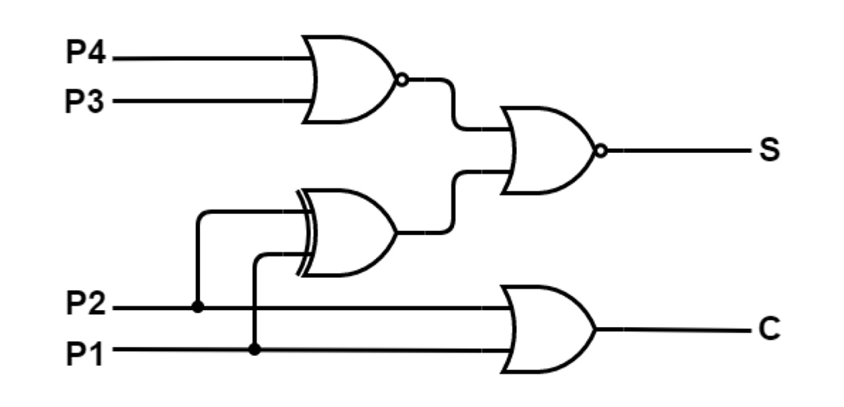
EXISTING SYSTEM
In Existing method 4-2 compressor is presented in Fig.1 (M. Zhang et al 2023) [10]. The compressor design consists of two NOR gates, one OR gate, and one XOR gate. It uses less transistors and has a probability of six faults out of sixteen input patterns, making it more competitive.
C = P1 + P2 (1)
S = (P1 · P2 + P1 · P2)(P3 + P4)
= (P1 ⊕ P2) + (P3 + P4) (2)

Slide 7
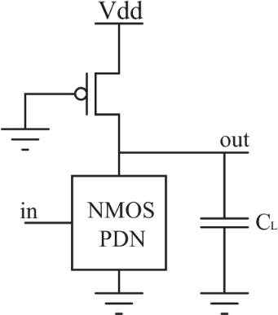
Proposed Pseudo-NMOS Based 4-2 Compressor
In pseudo NMOS logic, the pull down network is constructed by NMOS, while an amalgamation of NMOS- PMOS transistors are employed in pull-up network. The general structure of the Pseuso-NMOS logic is shown in Fig. 2.
By the comparison of Static and Pseudo NMOS circuits, it has more advantages in the elimination of input capacitance and area, because a N number of transistors in the Pull up network were eliminated and it have been replaced by a single PMOS transistor with ground input.
General Structure of the Pseudo-NMOS logic

Slide 8
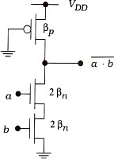
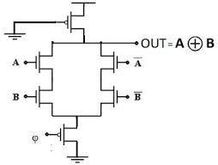
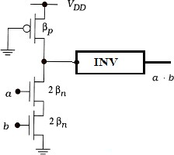
Proposed Pseudo-NMOS Based 4-2 Compressor
Pseudo-NMOS based NOR-Gate
Pseudo-NMOS based XOR-Gate
Pseudo-NMOS based OR-Gate

Slide 9
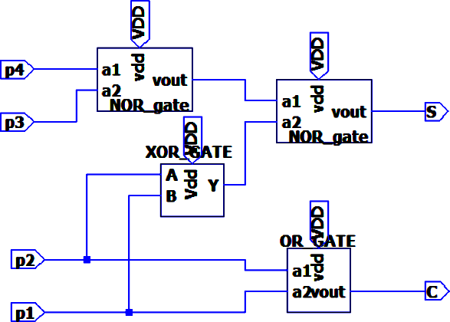
EXPERIMENTAL CIRCUIT DIAGRAM
Schematic Blocks of the Proposed 4-2 Compressor

Slide 10
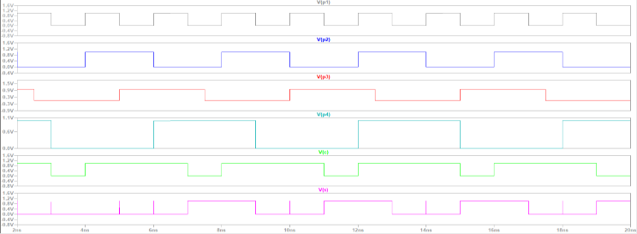
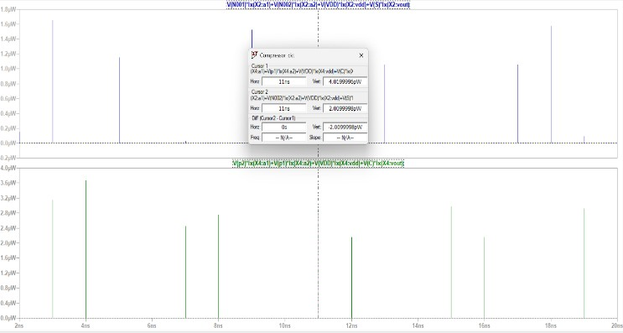
OUTPUT
Simulation Waveform of the Proposed 4-2 Compressor
Power Measurement of 4-2 Compressor

Slide 11
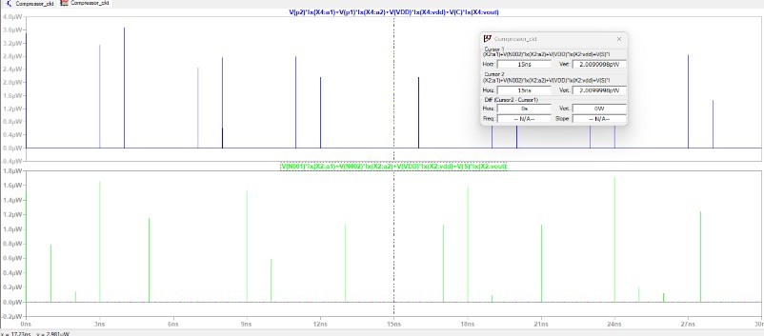
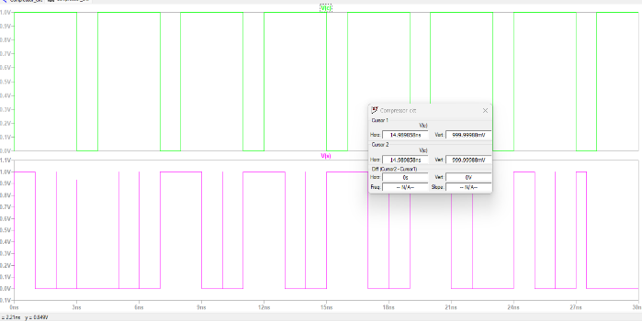
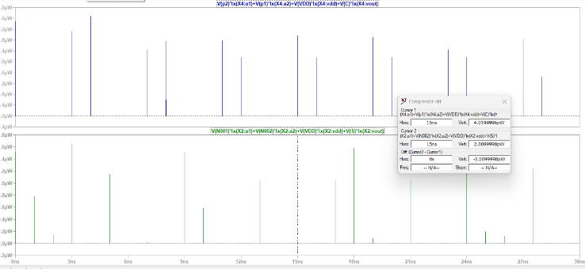
PROPOSED OUTPUT
Current Measurement of 4-2 Compressor
power Measurement of the proposed 4-2 Compressor
Current Measurement of the proposed 4-2 Compressor

Slide 12
CONCLUSION
In summary, the project successfully designed a low-power 4:2 compressor using pseudo-NMOS logic.
By prioritizing power efficiency and maintaining performance, it effectively reduces four input bits to two output bits. The compressor's optimized design minimizes area usage, facilitating seamless integration into digital circuits.
Overall, this project contributes to advancing energy-efficient solutions for modern VLSI technologies.

Slide 13
REFERENCE
[1] V. S. Nagaraju, P. Ashok Babu, B. Sadgurbabu, and R. R. Vallabhuni, "Design and Implementation of Low power FinFET based Compressor," in coimbatore, India, 2021, at the 3rd International Conference on Signal Processing and Communication (ICPSC), pages 532–536. doi: 10.1109/ICSPC51351.2021.9451693.
[2] A. Abhilash, R., S. Dubey, and M. C. Chinnaaiah, "Asic design of low power VLSI architecture for different multiplier algorithms using compressors," in Proceedings of the 11th International Conference on Industrial and Information Systems (ICIIS), Roorkee, India, 2016, pp. 387-392, doi: 10.1109/ICIINFS.2016.8262971.
[3] Kumar and Kumar (2014) used XOR and OR logic to develop a 4-2 compressor circuit.The recommended circuit used energy at different rates, ranging from 718.72 pW to 3357.40 pW.The maximum output delay was between 27.74 and 43.83 ps.On TSMC 0.18μm CMOS technology, simulations were run using SPICE.
[4] V. Anandi, R. Rangarajan, and M. Ramesh, "Low power VLSI compressors," in Proceedings of the 2013 International Conference on Green Computing, Communication, and Conservation of Energy (ICGCE), Chennai,2013,pp.231-236,doi: 10.1109/ICGCE.2013.6823483.
[5] Pishvaie, G. Jaberipur, and A. Jahanian, "Redesigned CMOS (4; 2) compressor for fast binary multipliers," Canadian Journal of Electrical and Computer Engineering, vol. 36, no. 3, Summer 2013, pp. 111-115, doi: 10.1109/CJECE.2013.6704692.

Slide 14


